Slide 1


The PiXL Club The PiXL Club The PiXL Club The PiXL Club The PiXL Club The PiXL Club The PiXL Club The PiXL Club The PiXL Club The PiXL Club The PiXL Club The PiXL Club The PiXL Club The PiXL Club The PiXL Club The PiXL Club The PiXL Club The PiXL Club The PiXL Club The PiXL Club The PiXL Club The PiXL Club The PiXL Club The PiXL Club The PiXL Club The PiXL Club The PiXL Club The PiXL Club The PiXL Club The PiXL Club The PiXL Club The PiXL Club The PiXL Club The PiXL Club The PiXL Club The PiXL Club The PiXL Club The PiXL Club The PiXL Club The PiXL Club The PiXL Club The PiXL Club The PiXL Club The PiXL Club The PiXL Club XL Club The PiXL Club The PiXL Club The PiXL Club The PiXL Club The PiXL Club The PiXL Club The PiXL Club The PiXL Club The PiXL Club The PiXL Club The PiXL Club The PiXL Club The PiXL Club The PiXL Club The PiXL Club The PiXL Club The PiXL Club The PiXL Club The PiXL Club The PiXL Club The PiXL Club The PiXL Club The PiXL Club The PiXL Club The PiXL Club The PiXL Club The PiXL Club The PiXL Club The PiXL Club The PiXL Club The PiXL Club The PiXL Club The PiXL Club The PiXL Club The PiXL Club The PiXL Club The PiXL Club The PiXL Club The PiXL Club The PiXL Club The PiXL Club The PiXL Club The PiXL Club The PiXL Club The PiXL Club The PiXL Club The PiXL Club The PiXL Club The PiXL Club The PiXL Club The PiXL Club The PiXL Club The PiXL Club The PiXL Club The PiXL Club The PiXL Club The PiXL Club The PiXL Club The PiXL Club The PiXL Club The PiXL Club The PiXL Club The PiXL Club The PiXL Club The PiXL Club The PiXL Club The PiXL Club The PiXL Club The PiXL Club The PiXL Club The PiXL Club The PiXL Club The PiXL Club The PiXL Club The PiXL Club The PiXL Club The PiXL Club The PiXL Club The PiXL Club The PiXL Club The PiXL Club The PiXL Club The PiXL Club The PiXL Club The PiXL Club The PiXL Club The PiXL Club The PiXL Club The PiXL Club The PiXL Club The PiXL Club The PiXL Club The PiXL Club The PiXL Club The PiXL Club The PiXL Club The PiXL Club The PiXL Club The PiXL Club The PiXL Club The PiXL Club The PiXL Club The PiXL Club The PiXL Club The PiXL Club The PiXL Club The PiXL Club The PiXL Club The PiXL Club The PiXL Club The PiXL Club The PiXL Club The PiXL Club The PiXL Club The PiXL Club The PiXL Club The PiXL Club The PiXL Club The PiXL Club The PiXL Club The PiXL Club The PiXL Club The PiXL Club The PiXL Club The PiXL Club The PiXL Club The PiXL Club The PiXL Club The PiXL Club The PiXL Club The PiXL Club The PiXL Club The PiXL Club The PiXL Club The PiXL Club The PiXL Club The PiXL Club The PiXL Club The PiXL Club The PiXL Club The PiXL Club The PiXL Club The PiXL Club The PiXL Club The PiXL Club The PiXL Club The PiXL Club The PiXL Club The PiXL Club The PiXL Club The PiXL Club The PiXL Club The PiXL Club The PiXL Club The PiXL Club The PiXL Club The PiXL Club The PiXL Club The PiXL Club The PiXL Club The PiXL Club The PiXL Club The PiXL Club The PiXL Club The PiXL Club The PiXL Club The PiXL Club The PiXL Club The PiXL Club The PiXL Club The PiXL Club The PiXL Club The PiXL Club The PiXL Club The PiXL Club The PiXL Club The PiXL Club The PiXL Club The PiXL Club The PiXL Club The PiXL Club The PiXL Club The PiXL Club The PiXL Club The PiXL Club The PiXL Club The PiXL Club The PiXL Club The PiXL Club The PiXL Club The PiXL Club The PiXL Club The PiXL Club The PiXL Club The PiXL Club The PiXL Club The PiXL Club The PiXL Club The PiXL Club The PiXL Club The PiXL Club The PiXL Club The PiXL Club The PiXL Club The PiXL Club The PiXL Club The PiXL Club The PiXL Club The PiXL Club The PiXL Club The PiXL Club The PiXL Club The PiXL Club The PiXL Club The PiXL Club The PiXL Club The PiXL Club The PiXL Club The PiXL Club The PiXL Club The PiXL Club The PiXL Club The PiXL Club The PiXL Club The PiXL Club The PiXL Club The PiXL Club The PiXL Club The PiXL Club The PiXL Club The PiXL Club The PiXL Club The PiXL Club The PiXL Club The PiXL Club The PiXL Club The PiXL Club The PiXL Club The PiXL Club The PiXL Club The PiXL Club The PiXL Club The PiXL Club The PiXL Club The PiXL Club The PiXL Club The PiXL Club The PiXL Club The PiXL Club The PiXL Club The PiXL Club The PiXL Club The PiXL Club The PiXL Club The PiXL Club The PiXL Club The PiXL Club The PiXL Club The PiXL Club The PiXL Club The PiXL Club The PiXL Club The PiXL Club The PiXL Club The PiXL Club The PiXL Club The PiXL Club The PiXL Club The PiXL Club The PiXL Club The PiXL Club The PiXL Club The PiXL Club The PiXL Club The PiXL Club The PiXL Club The PiXL Club The PiXL Club The PiXL Club The PiXL Club The PiXL Club The PiXL Club The PiXL Club The PiXL Club The PiXL Club The PiXL Club The PiXL Club The PiXL Club The PiXL Club The PiXL Club The PiXL Club The PiXL Club The PiXL Club The PiXL Club The PiXL Club The PiXL Club The PiXL Club The PiXL Club The PiXL Club The PiXL Club The PiXL Club The PiXL Club The PiXL Club The PiXL Club The PiXL Club The PiXL Club The PiXL Club The PiXL Club The PiXL Club The PiXL Club The PiXL Club The PiXL Club The PiXL Club The PiXL Club The PiXL Club The PiXL Club The PiXL Club The PiXL Club The PiXL Club The PiXL Club The PiXL Club The PiXL Club The PiXL Club The PiXL Club The PiXL Club The PiXL Club The PiXL Club The PiXL Club The PiXL Club The PiXL Club The PiXL Club The PiXL Club The PiXL Club The PiXL Club The PiXL Club The PiXL Club The PiXL Club The PiXL Club The PiXL Club The PiXL Club The PiXL Club The PiXL Club The PiXL Club The PiXL Club The PiXL Club The PiXL Club The PiXL Club The PiXL Club The PiXL Club The PiXL Club The PiXL Club The PiXL Club The PiXL Club The PiXL Club The PiXL Club The PiXL Club The PiXL Club The PiXL Club The PiXL Club The PiXL Club The PiXL Club The PiXL Club The PiXL Club The PiXL Club The PiXL Club The PiXL Club The PiXL Club The PiXL Club The PiXL Club The PiXL Club The PiXL Club The PiXL Club The PiXL Club The PiXL Club The PiXL Club The PiXL Club The PiXL Club The PiXL Club The PiXL Club The PiXL Club The PiXL Club The PiXL Club The PiXL Club The PiXL Club The PiXL Club The PiXL Club The PiXL Club The PiXL Club The PiXL Club The PiXL Club The PiXL Club The PiXL Club The PiXL Club The PiXL Club The PiXL Club The PiXL Club The PiXL Club The PiXL Club The PiXL Club The PiXL Club The PiXL Club The PiXL Club The PiXL Club The PiXL Club The PiXL Club The PiXL Club The PiXL Club The PiXL Club The PiXL Club The PiXL Club The PiXL Club The PiXL Club The PiXL Club The PiXL Club The PiXL Club The PiXL Club The PiXL Club The PiXL Club The PiXL Club The PiXL Club The PiXL Club The PiXL Club The PiXL Club The PiXL Club The PiXL Club The PiXL Club The PiXL Club The PiXL Club The PiXL Club The PiXL Club The PiXL Club The PiXL Club The PiXL Club The PiXL Club The PiXL Club The PiXL Club The PiXL Club The PiXL Club The PiXL Club The PiXL Club The PiXL Club The PiXL Club The PiXL Club The PiXL Club The PiXL Club The PiXL Club The PiXL Club The PiXL Club The PiXL Club The PiXL Club The PiXL Club The PiXL Club The PiXL Club The PiXL Club The PiXL Club The PiXL Club The PiXL Club The PiXL Club The PiXL Club The PiXL Club The PiXL Club The PiXL Club The PiXL Club The PiXL Club The PiXL Club The PiXL Club The PiXL Club The PiXL Club The PiXL Club The PiXL Club The PiXL Club The PiXL Club The PiXL Club The PiXL Club The PiXL Club The PiXL Club The PiXL Club The PiXL Club The PiXL Club The PiXL Club The PiXL Club The PiXL Club The PiXL Club The PiXL Club The PiXL Club The PiXL Club The PiXL Club The PiXL Club The PiXL Club The PiXL Club The PiXL Club The PiXL Club The PiXL Club The PiXL Club The PiXL Club The PiXL Club The PiXL Club The PiXL Club The PiXL Club The PiXL Club The PiXL Club The PiXL Club The PiXL Club The PiXL Club The PiXL Club The PiXL Club The PiXL Club The PiXL Club The PiXL Club The PiXL Club The PiXL Club The PiXL Club The PiXL Club The PiXL Club The PiXL Club The PiXL Club The PiXL Club The PiXL Club The PiXL Club The PiXL Club The PiXL Club The PiXL Club The PiXL Club The PiXL Club The PiXL Club The PiXL Club The PiXL Club The PiXL Club The PiXL Club The PiXL Club The PiXL Club The PiXL Club The PiXL Club The PiXL Club The PiXL Club The PiXL Club The PiXL Club The PiXL Club The PiXL Club The PiXL Club The PiXL Club The PiXL Club The PiXL Club The PiXL Club The PiXL Club The PiXL Club The PiXL Club The PiXL Club The PiXL Club The PiXL Club The PiXL Club The PiXL Club The PiXL Club The PiXL Club The PiXL Club The PiXL Club The PiXL Club The PiXL Club The PiXL Club The PiXL Club The PiXL Club The PiXL Club The PiXL Club The PiXL Club The PiXL Club The PiXL Club The PiXL Club The PiXL Club The PiXL Club The PiXL Club The PiXL Club The PiXL Club The PiXL Club The PiXL Club The PiXL Club The PiXL Club The PiXL Club The PiXL Club The PiXL Club The PiXL Club The PiXL Club The PiXL Club The PiXL Club The PiXL Club The PiXL Club The PiXL Club The PiXL Club The PiXL Club The PiXL Club The PiXL Club The PiXL Club The PiXL Club The PiXL Club The PiXL Club The PiXL Club The PiXL Club The PiXL Club The PiXL Club The PiXL Club The PiXL Club The PiXL Club The PiXL Club The PiXL Club The PiXL Club The PiXL Club The PiXL Club The PiXL Club The PiXL Club The PiXL Club The PiXL Club The PiXL Club The PiXL Club The PiXL Club The PiXL Club The PiXL Club The PiXL Club The PiXL Club The PiXL Club The PiXL Club The PiXL Club The PiXL Club The PiXL Club The PiXL Club The PiXL Club The PiXL Club The PiXL Club The PiXL Club The PiXL Club The PiXL Club The PiXL Club The PiXL Club The PiXL Club The PiXL Club The PiXL Club The PiXL Club The PiXL Club The PiXL Club The PiXL Club The PiXL Club The PiXL Club The PiXL Club The PiXL Club The PiXL Club The PiXL Club The PiXL Club The PiXL Club The PiXL Club The PiXL Club The PiXL Club The PiXL Club The PiXL Club The PiXL Club The PiXL Club The PiXL Club The PiXL Club The PiXL Club The PiXL Club The PiXL Club The PiXL Club The PiXL Club The PiXL Club The PiXL Club The PiXL Club The PiXL Club The PiXL Club The PiXL Club The PiXL Club The PiXL Club The PiXL Club The PiXL Club The PiXL Club The PiXL Club The PiXL Club The PiXL Club The PiXL Club The PiXL Club The PiXL Club The PiXL Club The PiXL Club The PiXL Club The PiXL Club The PiXL Club The PiXL Club The PiXL Club The PiXL Club The PiXL Club The PiXL Club The PiXL Club The PiXL Club The PiXL Club The PiXL Club The PiXL Club The PiXL Club The PiXL Club The PiXL Club The PiXL Club The PiXL Club The PiXL Club The PiXL Club The PiXL Club
PiXL KnowIT!
GCSE Physics
AQA Topic – Particle Model of Matter
© Copyright The PiXL Club Ltd, 2017
This resource is strictly for the use of member schools for as long as they remain members of The PiXL Club. It may not be copied, sold nor transferred to a third party or used by the school after membership ceases. Until such time it may be freely used within the member school.
All opinions and contributions are those of the authors. The contents of this resource are not connected with nor endorsed by any other company, organisation or institution.
www.pixl.org.uk The PiXL Club Ltd, Company number 07321607

Slide 2

Overview
Particle Model of Matter
Changes of state and the particle model
  Density of materials
  Changes of state
Internal energy and energy transfers
  Internal energy
  Temperature changes in a system and specific heat capacity
  Changes of heat and specific latent heat
Particle model and pressure
  Particle motion in gases
  Pressure in gases (physics only)
  Increasing the pressure of a gas (physics only – Higher Tier)

Slide 3
LearnIT!
KnowIT!
Changes of state and the particle model
Density of materials
Changes of state

Slide 4
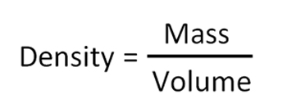
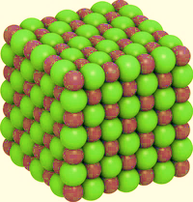
  Changes of state and the particle model – Density of materials
Density is the mass of a given volume of a substance
The density of a substance is
determined by the mass of
the atoms it is made from and
how closely these atoms are mass in kg
packed together. volume in m³
What is the density of a bar of gold if its volume is 350 cm³ (0.00035 m³) and its mass is 6.76 kg?
Density ᵨ = mass (kg) = 6.76
volume (m³) 0.00035
Density of gold = 19 314 kg/m³
Substance | Density (kg/m³)
Water (l) | 1 000
Glass (s) | 3 140
Iron (s) | 7 700
Aluminium (s) | 2 800
Hydrogen (g) | 0.085

Slide 5
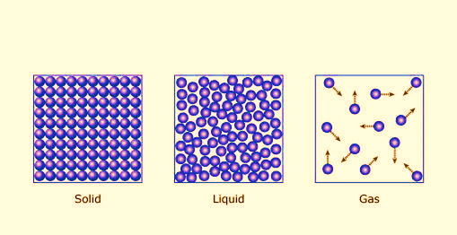
  Changes of state and the particle model – Density of materials
Density also depends on the state of a substance.
In solids the particles are packed close together.
In liquids the particles are free to move so the same mass takes up more space.
In gases the particles take up a much greater volume than in liquids and solids.
Solid Liquid Gas
For any particular substance, a solid is usually denser than its liquid and the liquid is usually denser than the gas.
However, there are exceptions to this. Solid water (ice) is less dense than liquid water. This is why ice floats on water.

Slide 6
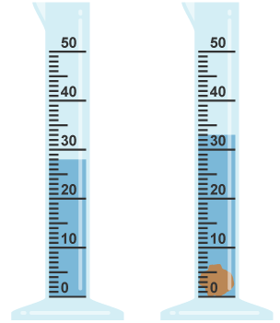
  Changes of state and the particle model –Density of materials
Finding the density of an irregular object
To find the density of an irregular shaped object, you need to determine its volume.
To do this, it is placed in a known volume of water and the amount of water displaced equals the volume of the object.
Piece of granite stone with a mass of 13.5 g (0.0135 kg)
Volume = 0.000005 m³
Increase in water level = volume of granite
(5 cm³)
Density of granite = 0.0135 kg = 2 690 kg/m³
0.000005 m³

Slide 7
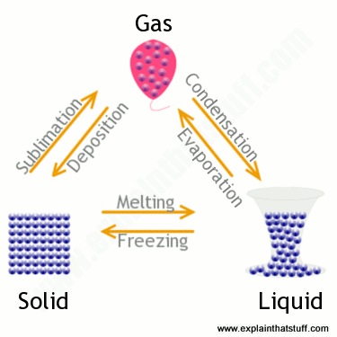
  Changes of state and the particle model – Changes of state
A change of state can be brought about by changing the temperature or pressure of a material.
If the solid shown has a mass of 1kg, then the liquid and gas will both have a mass of
1 kg.
Mass is conserved when a substance changes state, only the volume changes.
Changes of state are physical changes not chemical changes.
The change can be reversed in a physical change so the material recovers its original properties.
This does not happen with a chemical change.
The arrows show the direction in change of state.

Slide 8
QuestionIT!
Changes of state and the particle model
Density of materials
Changes of state

Slide 9
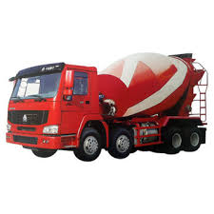
  Changes of state and the particle model – AnswerIT
Why is it incorrect to say iron is heavier than wood?
2. Water has a density of 1000 kg/m³. A piece of rubber has a density
of 1024 kg/m³. Explain what would happen if the rubber was put in
a pool of water?
3. This “ready-mix” concrete waggon contains
9600 kg of concrete. If the density of the
concrete is 2400 kg/m³, what volume of
concrete does the waggon contain?

Slide 10
  Changes of state and the particle model – AnswerIT
4. a. A sheet of insulating foam measures 3 m x 1 m x 0.08 m. It has a
mass of 9.6 kg. Calculate the density of the insulating foam.
b. High density foam is made of the same material and can be used
to give better insulation for the same thickness of foam. Describe
how the arrangement of particles would differ in these two types
of foam (you may draw diagrams to help your answer).
5. When copper metal is heated to 1100 ºC it melts.
a. Is this a chemical or physical change? Explain your answer.
b. What will happen to the mass of the sample of copper after it has
melted? Explain your answer.

Slide 11
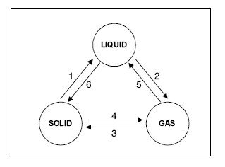

  Changes of state and the particle model – AnswerIT
6. Explain the difference between a physical and a chemical change.
7. Name the changes in state given in
the diagram by the arrows 1 to 6.
8. If you wanted to find the density of a brass key, you first need to
measure its volume. Describe how to determine the volume of a
brass key.

Slide 12

AnswerIT!
Changes of state and the particle model
Density of materials
Changes of state

Slide 13
  Changes of state and the particle model – AnswerIT
Why is it incorrect to say iron is heavier than wood?
It depends how much iron and wood you have. You should say iron
is denser than wood.
2. Water has a density of 1000 kg/m³. A piece of rubber has a density
of 1024 kg/m³. Explain what would happen if the rubber was put in
a pool of water?
Rubber has a higher density than water so the rubber would sink
in water.
3. This “ready-mix” concrete waggon contains
9600 kg of concrete. If the density of the
concrete is 2400 kg/m³, what volume of
concrete does the waggon contain?
Density = m v = mass = 9600 kg = 4
v density 2400 kg/m³
volume of concrete in the waggon = 4 m³

Slide 14
  Changes of state and the particle model – AnswerIT
4. a. A sheet of insulating foam measures 3 m x 1 m x 0.08 m. It has a
mass of 9.6 kg. Calculate the density of the insulating foam.
V = 3 x 1 x 0.08 = 0.24 m³ Density = 9.6 / 0.24 = 40 kg/m³
b. High density foam is made of the same material and can be used
to give better insulation for the same thickness of foam. Describe
how the arrangement of particles would differ in these two types
of foam (you may draw diagrams to help your answer).
Particles in the high density foam will be closer together so there
are more particles in a given volume, making it denser.
5. When copper metal is heated to 1100 ºC it melts.
a. Is this a chemical or physical change? Explain your answer.
Physical change. No new products have been formed.
b. What will happen to the mass of the sample of copper after it has
melted? Explain your answer.
It will stay the same. Mass is conserved when state changes.

Slide 15
  Changes of state and the particle model – AnswerIT
6. Explain the difference between a physical and a chemical change.
In a physical change no new products are formed and it can be
easily reversed.
In a chemical change a new substance is formed which can not
easily be changed back .
7. Name the changes in state given in
the diagram by the arrows 1 to 6.
1. melting 2. evaporating 3. deposition
4. subliming 5. condensing 6. freezing
8. If you wanted to find the density of a brass key, you first need to
measure its volume. Describe how to determine the volume of a
brass key.
Drop the key into a known volume of water and
measure the amount of water displaced by the key.
This will be the volume of the key.

Slide 16
LearnIT!
KnowIT!
Internal energy and energy transfers
Internal energy
Temperature change in a system and specific heat capacity
Changes of heat and specific latent heat

Slide 17
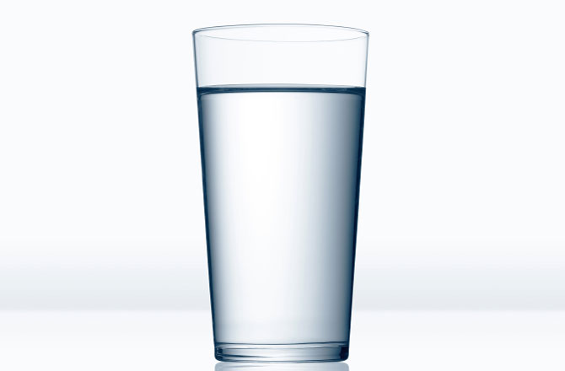
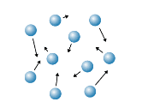
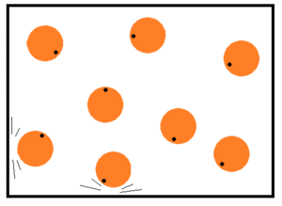
  Internal energy and energy transfers – Internal energy
Internal energy is the energy stored in a system by the atoms and molecules that make up that system.
The molecules of water have kinetic (movement) energy and some potential energy. The total kinetic (E_{k}) and potential (E_{p}) energy in the system make up the internal energy (U).
The particles inside a liquid or a gas are in constant motion, colliding with each other and the walls of any container they are in.
In a solid the particles are vibrating around a fixed point.

Slide 18
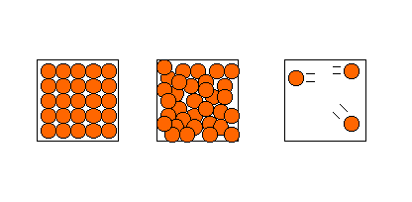
  Internal energy and energy transfers – Internal energy
When heat is added to a system the internal energy of the particles increases. This can result in the material changing state.
In a solid, particles can only vibrate so they cannot move relative to each other. When the solid is heated the particles gain kinetic energy and vibrate faster and faster.
In a liquid, the particles are moving fast enough to break free from the solid. They are free to move relative to each other but are held within a container.
In a gas, the particles have sufficient energy to break free from their container. Gas particles can move away from their container and away from other gas particles.

Slide 19
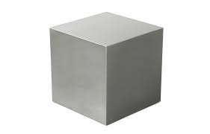
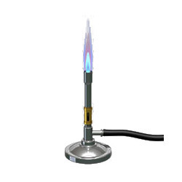
  Internal energy and energy transfers –
  Temperature change in a system and specific heat capacity
The temperature increase of an object depends on what it is made of, the mass of the object and the amount of energy put into it.
Mass of system
(kg)
Type of material (specific heat capacity) (J/kg ºC)
To calculate the temperature change, the formula for specific heat capacity has to be re-arranged.
Remember, specific heat capacity (c) is the energy required to raise the temperature of 1 kg of a substance by 1ºC.
Energy input (thermal)
(J)
Temperature change (Δθ) = ___change in thermal energy (ΔE)__
mass (m) x specific heat capacity (C )

Slide 20
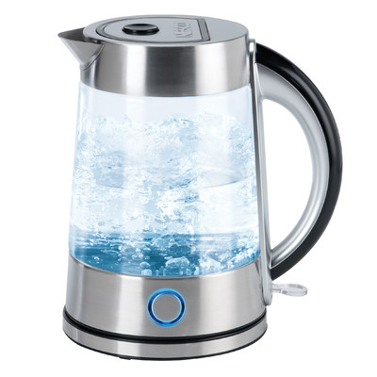
  Internal energy and energy transfers –
  Temperature change in a system and specific heat capacity
Calculating temperature change
A kettle contains 1400 g of water at 12 ºC.
If 400 kJ of heat energy is supplied to the water, how much will the temperature rise?
Temperature change (Δθ) = change in thermal energy (ΔE) mass (m) x specific heat capacity (C)
Δθ = ΔE = 400 000 = 68 ºC
m x C 1.4 x 4200
The temperature rise will be 68 ºC.
The new temperature of the water will be 68 + 12 = 80 ºC.

Slide 21

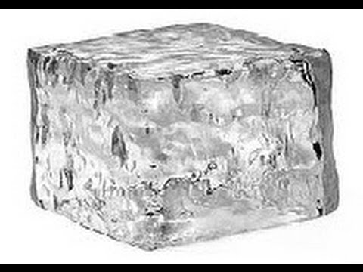
  Internal energy and energy transfers –
  Changes of heat and specific latent heat
Latent heat is the energy needed to change the state of a substance without a change in temperature.
The energy supplied is used to change the internal energy store of the substance.
Latent heat for melting is called specific latent heat of fusion (L_{f})
Latent heat for evaporating is called specific latent heat of vaporisation (L_{v})
1kg of ice at 0ºC 1kg water at 0ºC
Specific latent heat of fusion for water = 336 000 J/kg
This means 336 000 J of energy are needed to turn 1 kg of ice into 1 kg of water with no temperature change.

Slide 22
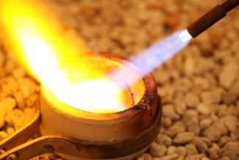
  Internal energy and energy transfers –
  Changes of heat and specific latent heat
5 g of gold is being melted to make a ring.
Once the gold reaches its melting temperature, how much heat energy is needed to melt the gold?
Specific latent heat of fusion for gold = 64 400 J/kg
Energy to change state (J) = mass (kg) x specific latent heat (J/kg)
Remember there are two latent heats for each substance – fusion and vaporisation.
Fusion – melting and freezing Vaporisation – evaporating and condensing
Energy = 0.0005 kg x 64,400 J/kg = 322 J
322 J of heat energy is needed to melt 5 g of gold

Slide 23
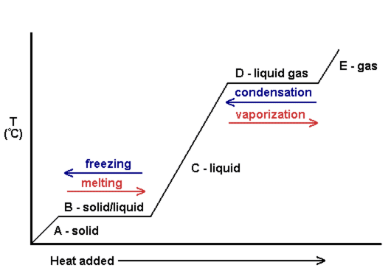
  Internal energy and energy transfers –
  Changes of heat and specific latent heat
Heating and cooling graphs
As heat energy is added to a solid, the temperature rises until it reaches its melting point.
As the substance melts, all the heat energy added is used to change the state of the substance with no temperature change.
When all the substance is melted, the temperature will then rise until the boiling point is reached.
Again, heat energy is now required to change the state to a gas with no temperature change.

Slide 24
QuestionIT!
Internal energy and energy transfers
Internal energy
Temperature change in a system and specific heat capacity
Changes of heat and specific latent heat

Slide 25
  Internal energy and energy transfers – AnswerIT
Define internal energy.
2. Which of the following will change the internal energy of a stone?
A. Lifting it to the top of a building.
B. Heating it.
C. Firing it from a catapult.
3. Water and the chemical isooctane both boil at 100 ºC. When the
same mass of each substance is placed on a heater, the
isooctane boils first. Explain why this happens.

Slide 26


  Internal energy and energy transfers – AnswerIT
4. A hot stone is placed into a glass of water containing 200 g
of cold water. The stone transfers 25 200 J of energy to
the water. How much will the temperature of the water rise?
Specific heat capacity of water = 4200 J/kg ºC ΔE = m c Δθ
5. What is specific latent heat?
6. Explain the difference between latent heat of fusion and latent heat of
vaporisation.

Slide 27
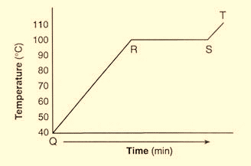
  Internal energy and energy transfers – AnswerIT
7. A boiler is being used to heat water. The graph shows the temperature of
the water every 5 minutes.
a. What state is the water in between points
Q and R?
b. At which point does the water begin
to boil?
c. What state is the water in at 110 ºC?
Candle wax has a latent heat of fusion of 200 000 J/kg. If the candle is at its melting temperature, how much heat energy is needed to melt a
250 g candle?
E = m L_{f}

Slide 28
AnswerIT!
Internal energy and energy transfers
Internal energy
Temperature change in a system and specific heat capacity
Changes of heat and specific latent heat

Slide 29
  Internal energy and energy transfers – AnswerIT
Define internal energy?
The total kinetic and potential energy of all the particles within a
system
2. Which of the following will change the internal energy of a stone?
A. Lifting it to the top of a building
B. Heating it
C. Firing it from a catapult
Heating it.
3. Water and the chemical isooctane both boil at 100 ºC. When the
same amount of each substance is placed on a heater, the
isooctane boils first. Explain why this happens.
Isooctane has a lower specific heat capacity than water so less heat energy is needed to raise its temperature to its
boiling point.

Slide 30
  Internal energy and energy transfers – AnswerIT
4. A hot stone is placed into a glass of water containing 200 g
of cold water. If the stone transfers 25 200 J of energy to
the water, what will the temperature rise of the water be?
specific heat capacity of water = 4200 J/kg ºC ΔE = m c Δθ
Δθ = ΔE = 25 200 = 30 ºC
m x c 0.2 x 4200
Temperature rise of the water = 30 ºC
5. What is latent heat?
The energy needed to change the state of a substance without
changing the temperature.
6. Explain the difference between latent heat of fusion and latent heat of
vaporisation.
Latent heat of fusion is the energy needed to change between
solid and liquid. Latent heat of vaporisation is the energy needed to change state between liquid and gas.

Slide 31
  Internal energy and energy transfers – AnswerIT
7. A boiler is being used to heat water. The graph shows the temperature of
the water every 5 minutes.
a. What state is the water in between points
Q and R?
Liquid
b. At which point does the water begin
to boil?
R
c. What state is the water in at 110 ºC?
Gas
Candle wax has a latent heat of fusion of 200 000 J/kg. If the candle is at its melting temperature, how much heat energy is needed to melt a
250 g candle?
E = m L_{f}
E = 0.25 x 200 000 = 50 000 J

Slide 32
LearnIT!
KnowIT!
Particle model
and pressure
Particle motion in gases
Pressure in gases (physics only)
Increasing the pressure of a gas
(physics only – Higher Tier)

Slide 33
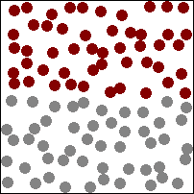
  Particle model and pressure- particle motion in gases
Molecules in a gas are in constant random motion (called Brownian motion)
The temperature of this gas is related to the average kinetic energy of all the particles.
If the temperature of the gas is increased, the particles will move faster.
Faster moving particles exert a greater force on the walls of the container.
This will either cause the container to expand (balloon) or increase the pressure of the gas (gas cylinder).
Particles of a gas inside a container have kinetic energy

Slide 34
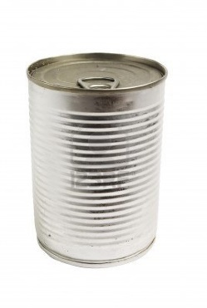
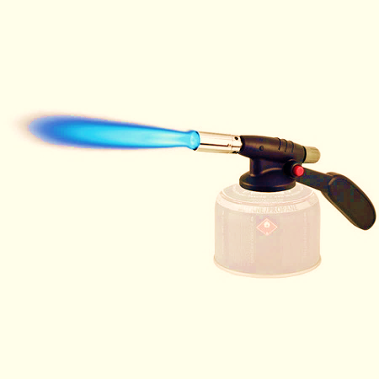
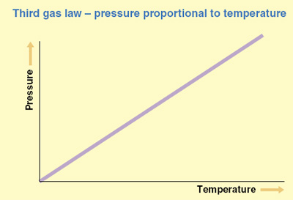
  Particle model and pressure- particle motion in gases
If a sealed can of air (gas) is heated, the molecules of air move faster and faster.
The collisions of these molecules on the inside walls of the container create a pressure. The hotter the molecules, the faster they move and the more pressure they exert on the wall of the can.
If the can continues to be heated, the pressure will keep rising steadily.
The graph opposite shows that gas pressure is directly related to its temperature, if the volume remains constant.

Slide 35
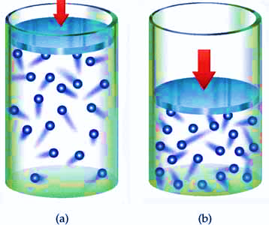
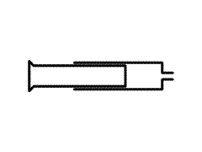

  Particle model and pressure- pressure in gases (physics only)
When a gas is compressed inside a fixed container, there are more particles in a given volume to strike the walls of the container, therefore the pressure on the container walls increases.
The pressure produces a net force at right angles to the wall which means the pressure will act evenly in all directions.
Think about a sealed syringe with a fixed amount of gas inside. The particles will be colliding with the syringe walls creating a pressure.
If the plunger is pulled out, the same amount (mass) of gas will be occupying a greater volume.
This will result in fewer collisions over a given area of the syringe wall.
Gas pressure will be reduced

Slide 36
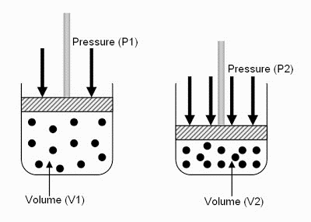
  Particle model and pressure - pressure in gases (physics only)
When a fixed mass of gas is compressed the volume decreases
In the example shown, if the pressure applied to the gas doubles, the volume halves.
This is an inverse relationship:
P = 1 or pV = constant
V
For calculations:
p₁V₁ = p₂V₂
If the container has a volume of 0.04 m³ and a pressure of 100 000 Pa, calculate the new volume if the pressure is increased to 320 000 Pa.
p₁V₁ = p₂V₂ V₂ = p₁V₁ = 100 000 x 0.04 New volume = 0.0125 m³
p₂ 320 000

Slide 37
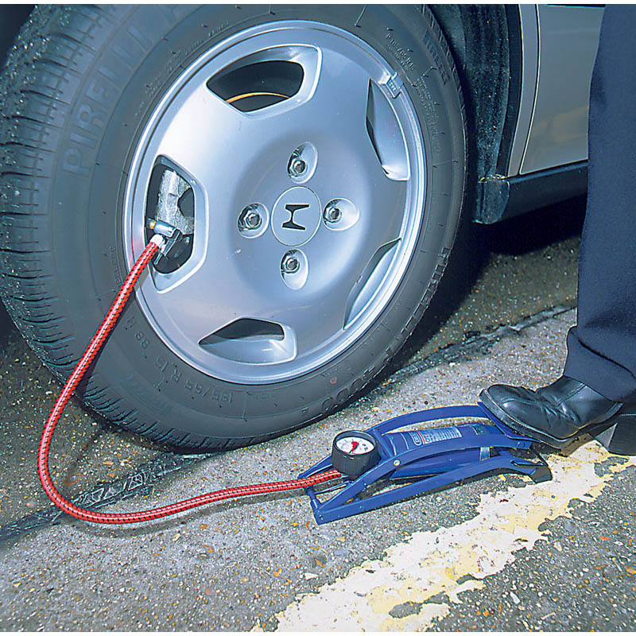
  Particle model and pressure- Increasing the pressure of a gas (physics only – Higher Tier)
When work is done on a gas, energy is transferred to the gas by a force. This transfer of energy to the gas increases its temperature.
When a foot pump is used to inflate a tyre, work is done by the piston on the vibrating air particles inside the pump. There is therefore a transfer of energy between the piston and the particles and this results in an increase in kinetic energy of the air particles.
If the kinetic energy of the air particles increases then there will be more collisions between gas particles. This will cause the temperature of the gas to rise

Slide 38
QuestionIT!
Particle model
and pressure
Particle motion in gases
Pressure in gases (physics only)
Increasing the pressure of a gas
(physics only – Higher Tier)

Slide 39
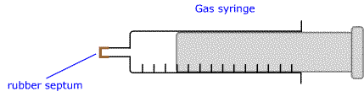
  Particle model and pressure – AnswerIT
What happens to the temperature of a gas if the average kinetic
energy of the particles of the gas increases?
2. The sealed gas syringe is filled with air.
Explain what will happen to the syringe if the air inside is gently
heated.
As a weather balloon rises high in the atmosphere its volume
increases. Explain why this happens.

Slide 40
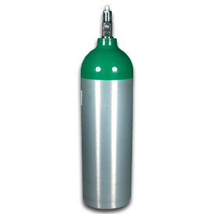
  Particle model and pressure – AnswerIT
4. A cylinder of oxygen is left in the sunshine for an hour.
a. Explain what will happen to the oxygen molecules
in the cylinder as they warm up.
b. Explain why these heated molecules cause a
greater pressure inside the cylinder.
When air is blown into a balloon, it expands equally in all
directions. The best explanation for this is:
A - The gas molecules in the balloon are expanding
B - Internal air pressure acts at right angles to the balloon
surface.
C - As more air is blown in, the temperature increases causing
the balloon to expand.

Slide 41
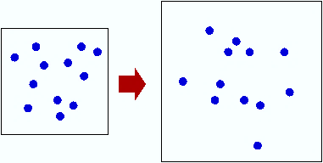
  Particle model and pressure – AnswerIT
6. Container A is filled with a gas represented by the dots. The
container size is increased but the mass of gas remains the same.
Container A Container B
a. Explain, using the particle model, why the pressure will be less
inside container B.
b. Container A has a volume of 2 m³ and a pressure of 100 000 Pa.
If the expanded container has a volume of 5 m³, what will the
pressure be in container B?

Slide 42
AnswerIT!
Particle model
and pressure
Particle motion in gases
Pressure in gases (physics only)
Increasing the pressure of a gas
(physics only – Higher Tier)

Slide 43
  Particle model and pressure – AnswerIT
What happens to the temperature of a gas if the average kinetic
energy of the particles of the gas increases?
The temperature will increase.
2. The sealed gas syringe is filled with air.
Explain what will happen to the syringe if the air inside is gently
heated.
The air molecules will gain kinetic energy. This will create a
greater force inside the syringe so the piston will move outwards.
As a weather balloon rises high in the atmosphere its volume
increases. Explain why this happens.
As the weather balloon gets higher the pressure on the outside of
the balloon decreases, making the balloon expand. The
temperature decreases as you get higher, but the effect of pressure
decreasing is greater.

Slide 44
  Particle model and pressure – AnswerIT
4. A cylinder of oxygen is left in the sunshine for an hour.
a. Explain what will happen to the oxygen molecules
in the cylinder as they warm up.
They will gain kinetic energy, so move faster.
b. Explain why these heated molecules cause a
greater pressure inside the cylinder.
The higher kinetic energy causes the molecules to hit the
surface of the cylinder more often and with greater force.
When air is blown into a balloon, it expands equally in all
directions. The best explanation for this is:
A - The gas molecules in the balloon are expanding
B - Internal air pressure acts at right angles to the balloon
surface.
C - As more air is blown in, the temperature increases causing
the balloon to expand.

Slide 45
  Particle model and pressure – AnswerIT
6. Container A is filled with a gas represented by the dots. The
container size is increased but the mass of gas remains the same.
Container A Container B
a. Explain, using the particle model, why the pressure will be less
inside container B.
Over a given area there will be fewer gas molecule collisions so
the pressure will be less.
b. Container A has a volume of 2 m³ and a pressure of 100 000 Pa.
If the expanded container has a volume of 5 m³, what will the
pressure be in container B?
p₁V₁ = p₂V₂ 100 000 x 2 = p₂ New pressure = 40 000Pa
5

